Slide 1
Twitter Data Sentiment Analysis for Public Opinion on Major Events
2210030353_Nayaneesh
2210030119_Medhansh
2210030264_BhargavArjun
2210030038_Umesh

Slide 2
01
Introduction

Slide 3
Overview of sentiment analysis
Sentiment analysis involves analyzing text data to determine the emotional tone behind it. It employs algorithms to classify sentiments as positive, negative, or neutral. Techniques like natural language processing (NLP) and machine learning are pivotal in extracting insights from vast data sets.

Slide 4
ROLE PLAY
Analyzing social media sentiments during major events, such as political elections or natural disasters, offers critical insights. It reflects public sentiments, helps predict trends in behavior, and assists organizations in responding effectively to public concerns.

Slide 5
02
Methodology

Slide 6
Data collection process
Data collection for sentiment analysis involves scraping social media platforms, using APIs to gather posts, comments, and reactions. It is essential to ensure a diverse dataset that accurately represents the demographics related to the studied events.

Slide 7
Analysis techniques
After data collection, various analysis techniques such as text mining, sentiment classification, and machine learning models are applied to interpret the data. Techniques like supervised learning and unsupervised learning play a significant role in deriving insights from the collected information.

Slide 8

Evaluation metrics
Evaluation metrics are essential to determine the effectiveness of sentiment analysis. Common metrics include accuracy, precision, recall, and F1 score, which help assess how well the models predict sentiments. Understanding these metrics enables researchers to optimize models for better performance and validate their findings using benchmark datasets.

Slide 9
03
Technologies

Slide 10
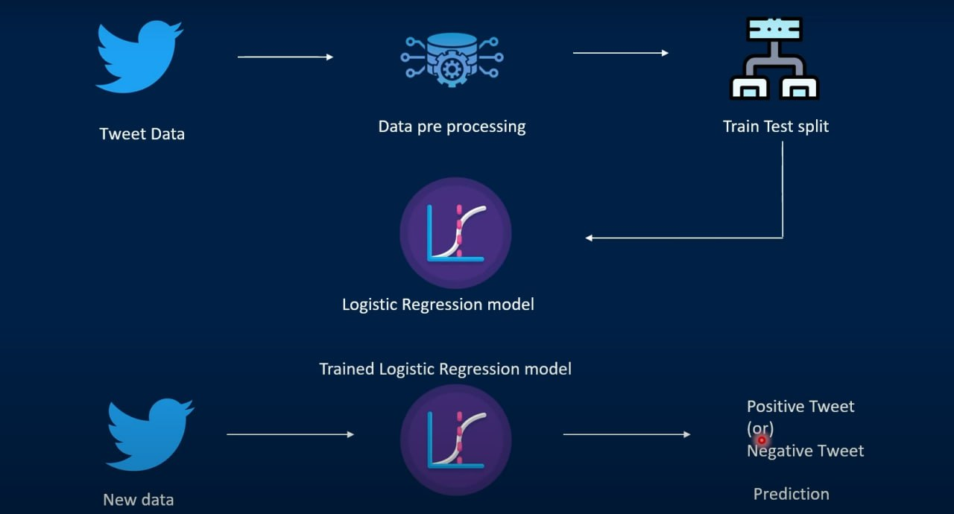

Slide 11
Programming languages used
Python is widely used in sentiment analysis due to its simplicity and powerful libraries like Pandas and NumPy for data handling. R is another language popular for statistical analysis. Additionally, languages like Java and Scala can be used for big data processing tasks associated with sentiment analysis.

Slide 12

Software tools and platforms
Tools like Jupyter Notebook, RapidMiner, and KNIME facilitate data analysis and visualization. Platforms such as Google Cloud and AWS provide cloud computing resources to handle vast datasets, enabling scalable sentiment analysis workflows and leveraging powerful computational resources.

Slide 13
Libraries and frameworks
Popular libraries for sentiment analysis include NLTK and spaCy for natural language processing tasks. TensorFlow and PyTorch are used for implementing machine learning models, while Scikit-learn aids in basic machine learning functionalities. These libraries ease the implementation of complex algorithms for sentiment analysis.

Slide 14
04
Models

Slide 15
Machine learning models applied
Commonly applied machine learning models include logistic regression, support vector machines, and decision trees. Recently, deep learning approaches like recurrent neural networks (RNNs) and transformers have gained traction for their ability to capture context and nuances in natural language, significantly enhancing sentiment detection accuracy.

Slide 16
Natural language processing techniques
Techniques such as tokenization, stemming, and lemmatization are fundamental in preparing text data. Advanced NLP methods like sentiment lexicons, word embeddings, and transformers facilitate more profound meaning extraction and context understanding, thus improving sentiment classification effectiveness.

Slide 17
Model evaluation and performance
Evaluating models involves testing them against validation datasets to measure their predictive performance using established evaluation metrics. Continuous tweaking and retraining are crucial to enhance model accuracy, with the goal of achieving reliable insights from sentiment data over time.

